Slide 1



Build Interactive Web App with R & Shiny
Prepared by : Aep Hidayatuloh
Email : aephidayatuloh.mail@gmail.com
GitHub : https://github.com/aephidayatuloh
RPubs : https://rpubs.com/aephidayatuloh

Slide 2

Syllabus
Pertemuan | Kompetensi Dasar | Materi
2 | Mengetahui jenis dan penggunaan input di shiny | Widgets Input
 |  | Text Input
 |  | TextArea Input
 |  | Numeric Input
 |  | Slider Input
 |  | File Input
 |  | Date & Date Range Input
 |  | Checkbox
 |  | Checkbox Group
 |  | Radio Button
 |  | Conditional Input
 |  | Action Button
 |  | Action Link
 |  | Download Button
 | Mengetahui jenis dan penggunaan output di shiny | Output
 |  | renderPlot() & plotOutput()
 |  | renderTable() & tableOutput()
 |  | renderPrint() & printOutput()
 |  | renderText() & textOutput() / verbatimTextOutput()
 |  | renderUI() & uiOutput()
 |  | render dan output dari package lain

Slide 3
Widgets
Widgets or input user interface allows user to interactively update the value of shiny app

Slide 4
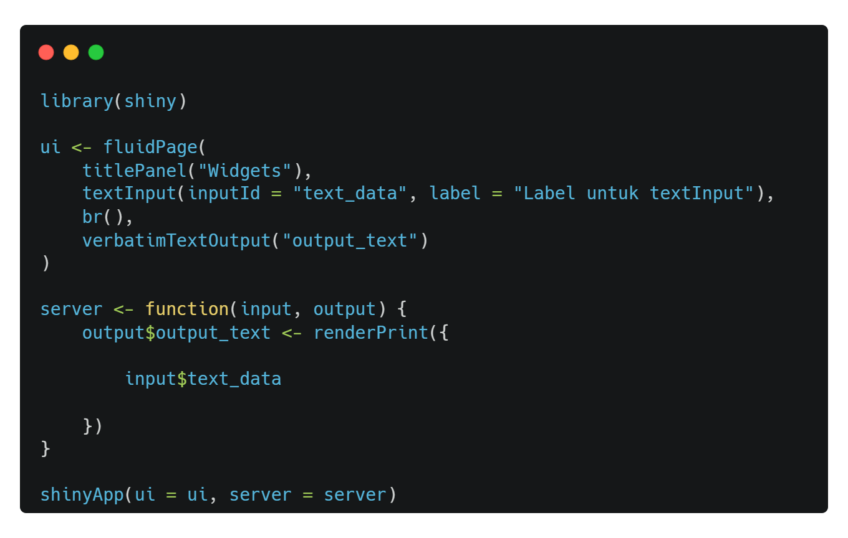
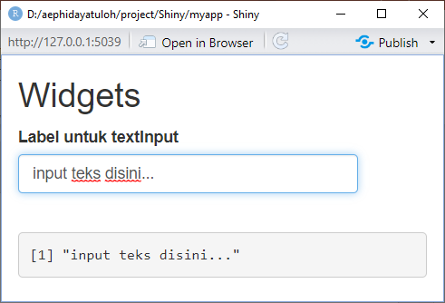
Text Input
textInput(inputId, label, value = "", width = NULL, placeholder = NULL)

Slide 5
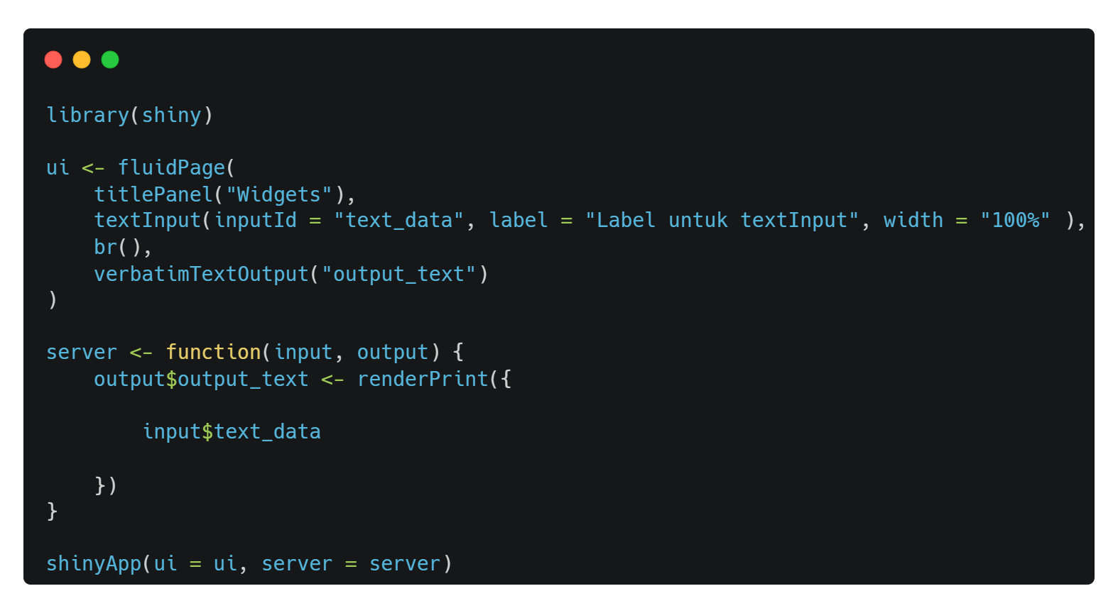
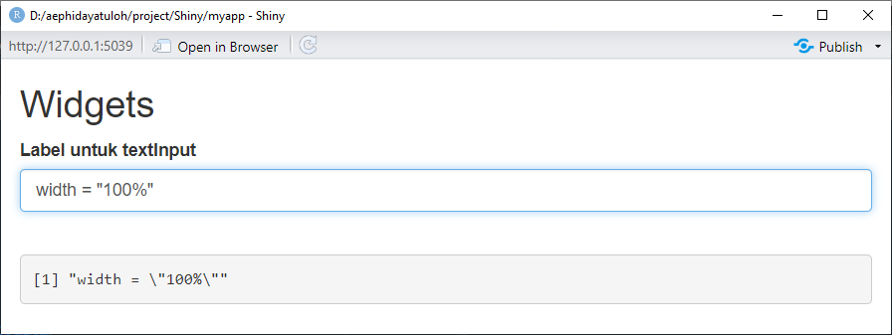
Text Input
textInput(inputId, label, value = "", width = NULL, placeholder = NULL)

Slide 6
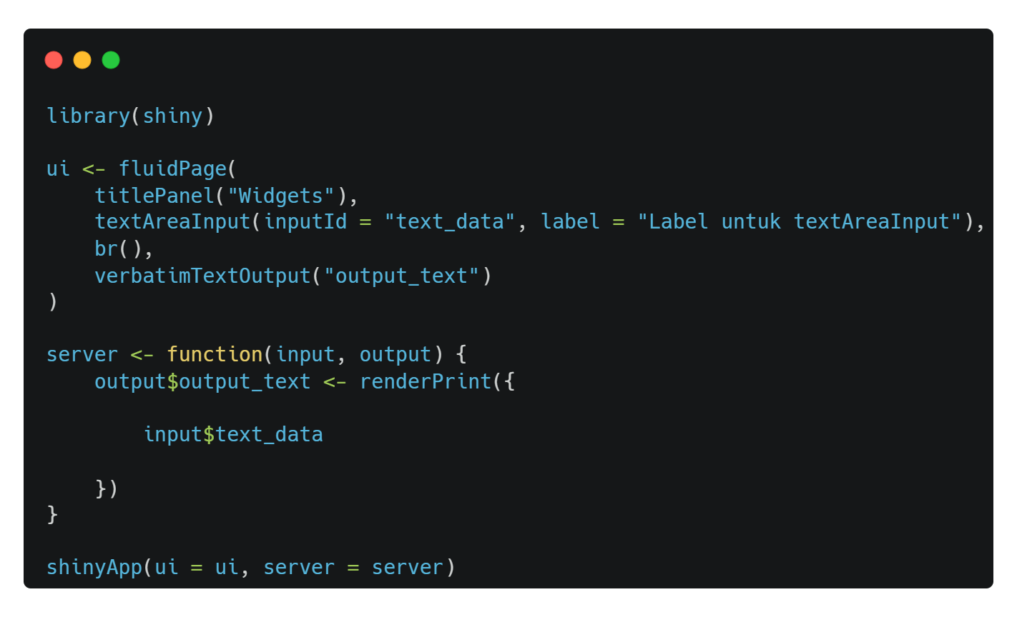
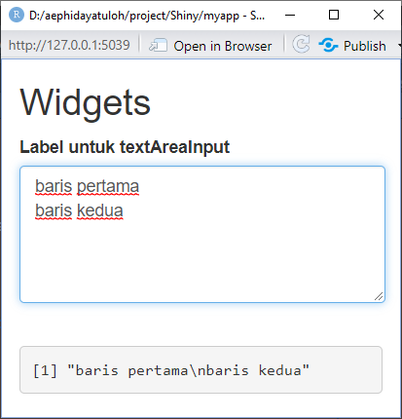
Text Area Input
textAreaInput(inputId, label, value = "", width = NULL, height = NULL,
cols = NULL, rows = NULL, placeholder = NULL, resize = NULL)

Slide 7
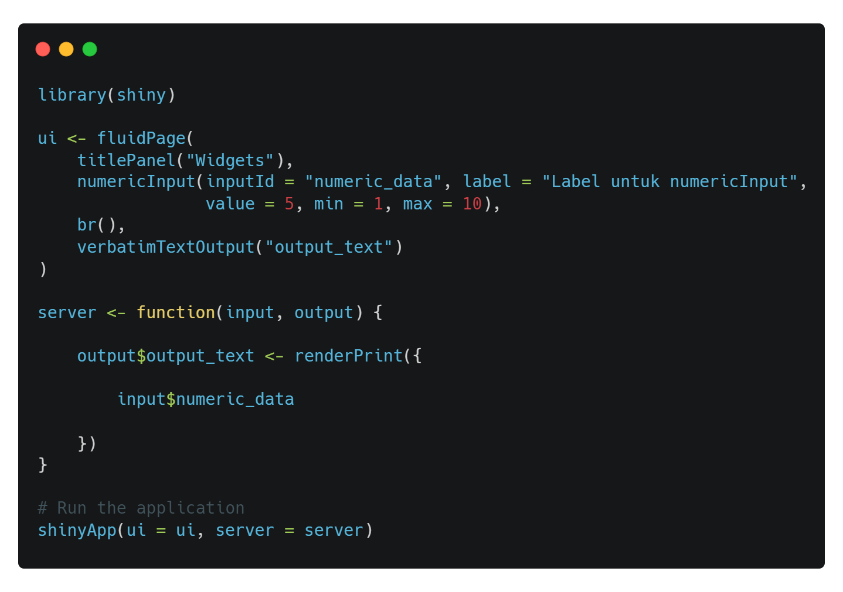
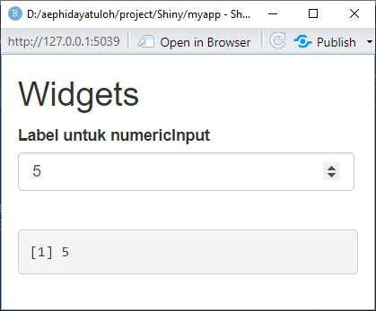
Numeric Input
numericInput(inputId, label, value, min = NA, max = NA, step = NA,
width = NULL)

Slide 8
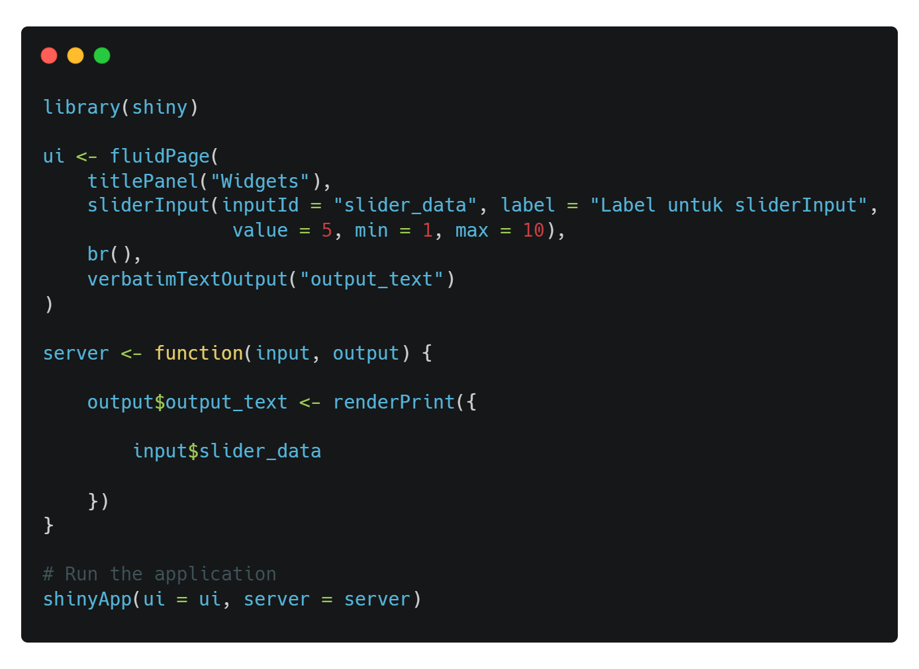
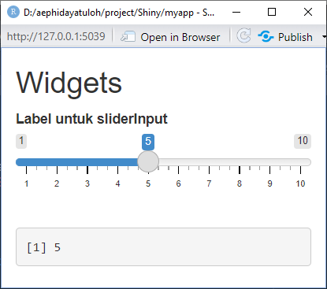
Slider Input
sliderInput(inputId, label, min, max, value, step = NULL, round = FALSE,
format = NULL, locale = NULL, ticks = TRUE, animate = FALSE,
width = NULL, sep = ",", pre = NULL, post = NULL, timeFormat = NULL,
timezone = NULL, dragRange = TRUE)

Slide 9
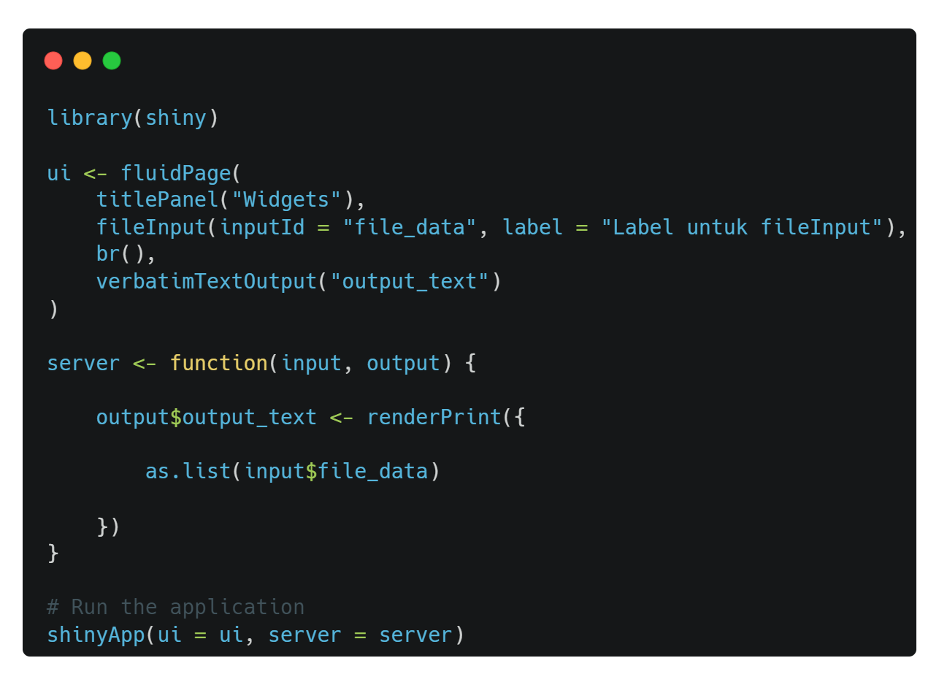
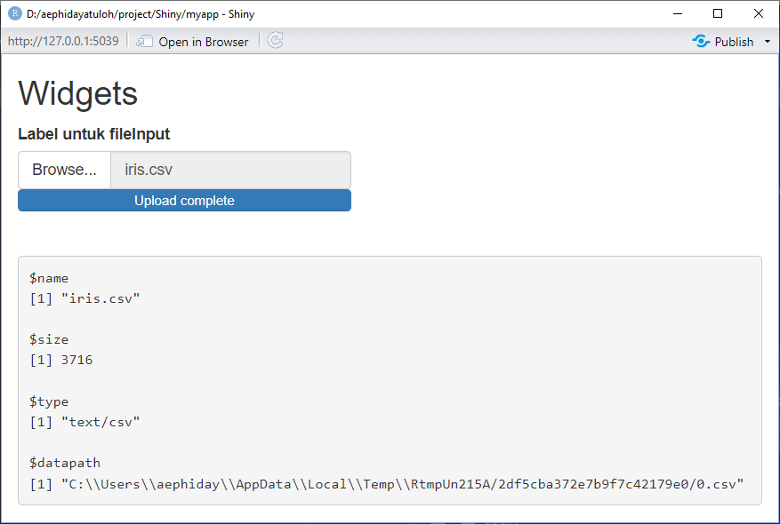
File Input
fileInput(inputId, label, multiple = FALSE, accept = NULL, width = NULL,
buttonLabel = "Browse...", placeholder = "No file selected")

Slide 10
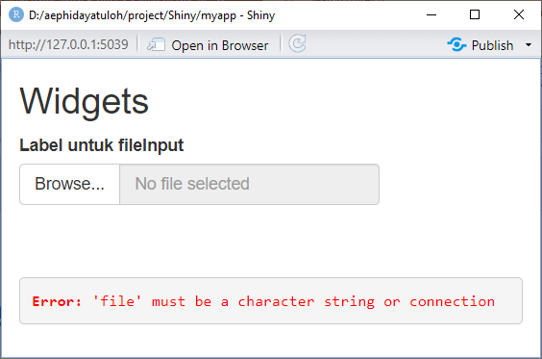
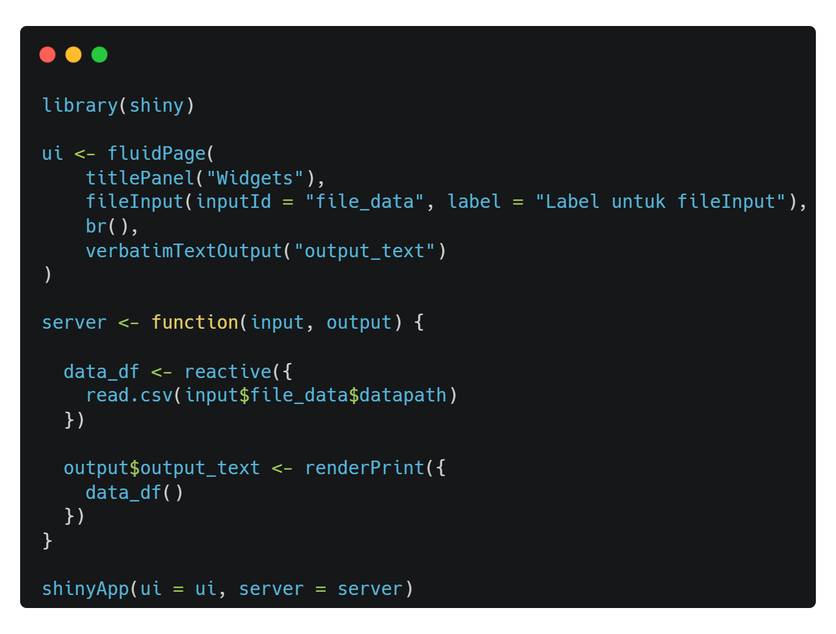
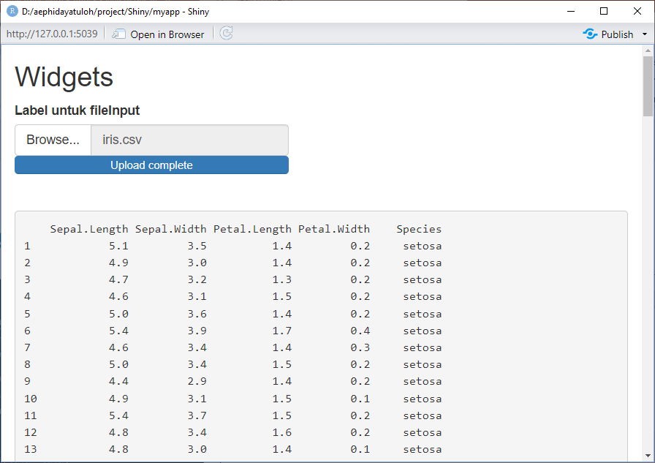
File Input

Slide 11
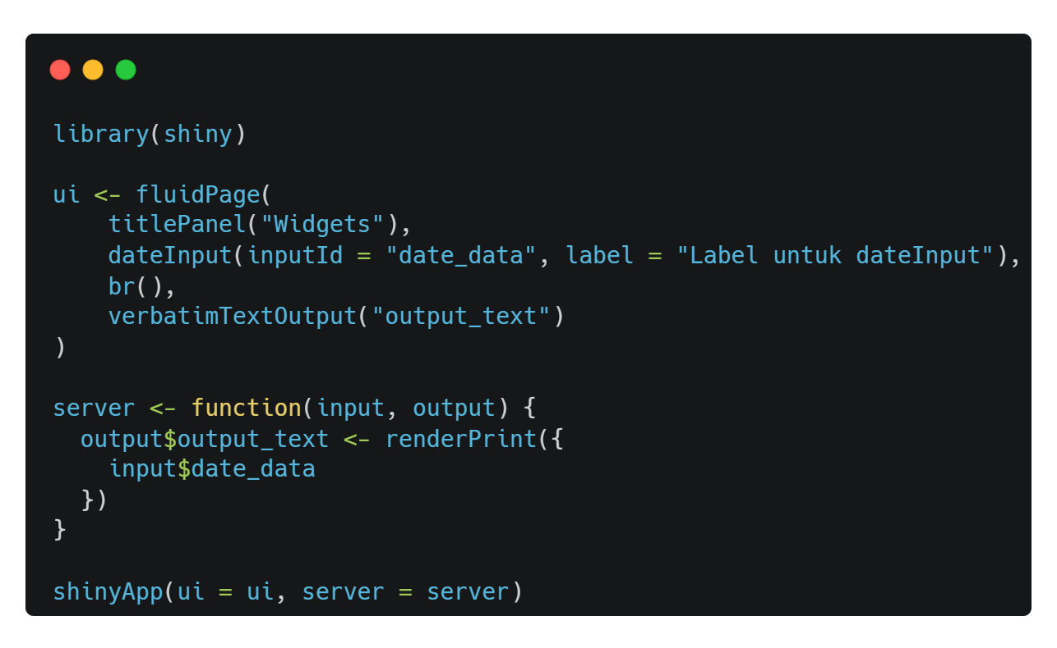
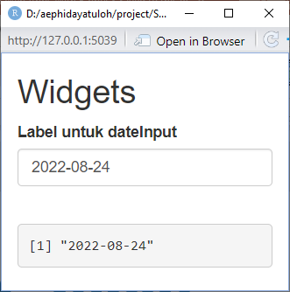
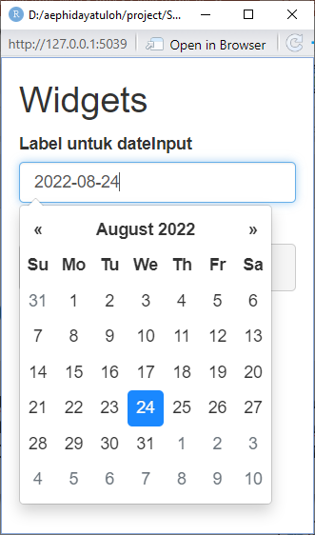
Date Input
dateInput(inputId, label, value = NULL, min = NULL, max = NULL,
format = "yyyy-mm-dd", startview = "month", weekstart = 0,
language = "en", width = NULL, autoclose = TRUE)

Slide 12
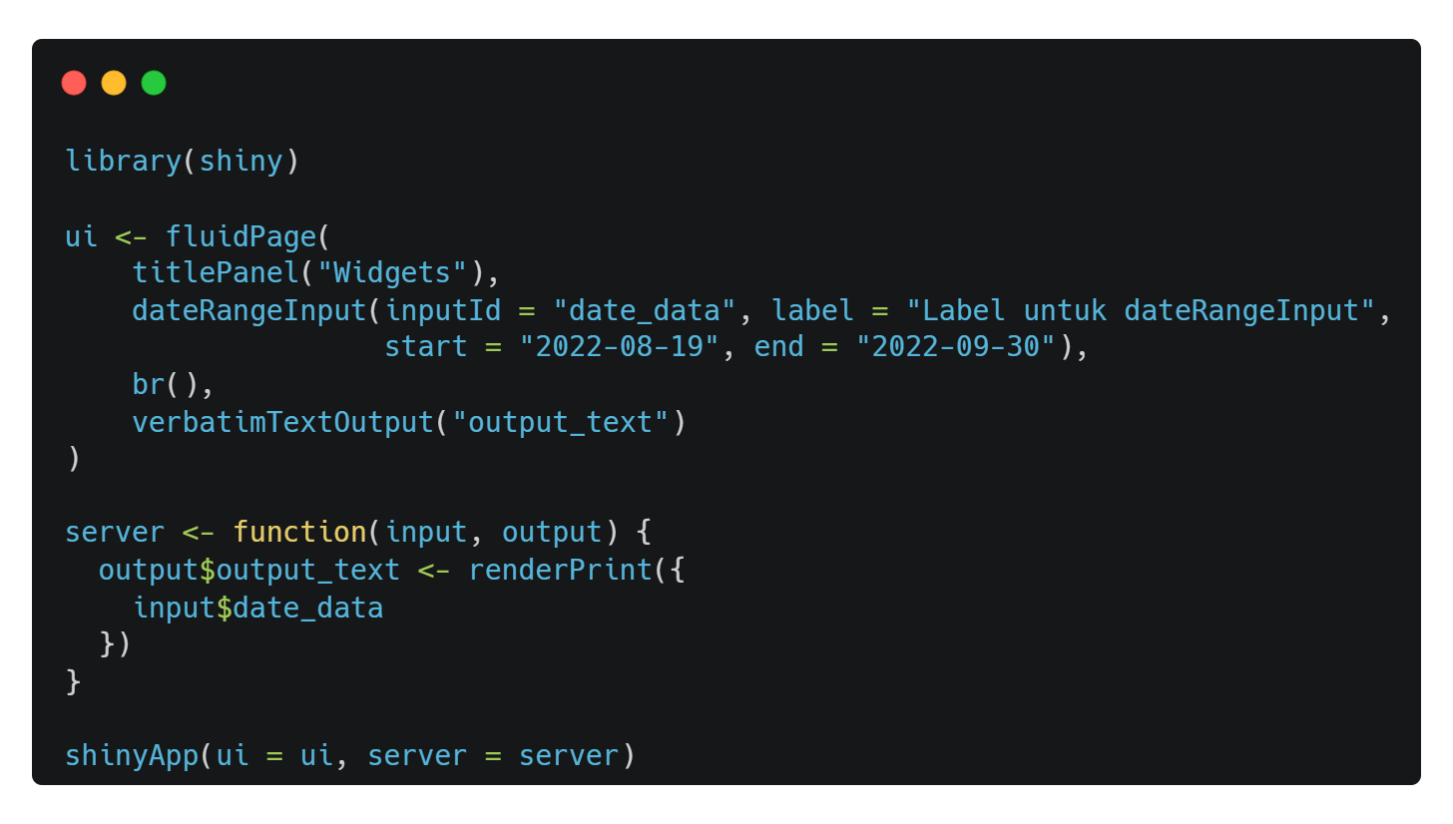
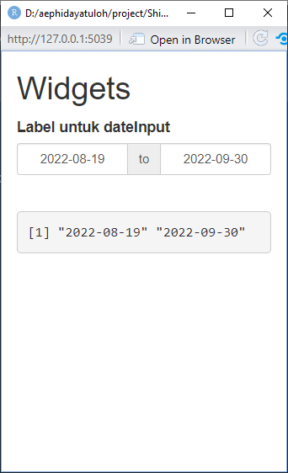
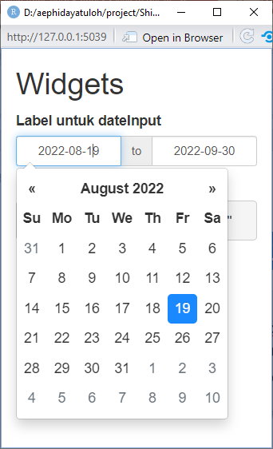
Date Range Input
dateRangeInput(inputId, label, start = NULL, end = NULL, min = NULL,
max = NULL, format = "yyyy-mm-dd", startview = "month", weekstart = 0,
language = "en", separator = " to ", width = NULL, autoclose = TRUE)

Slide 13
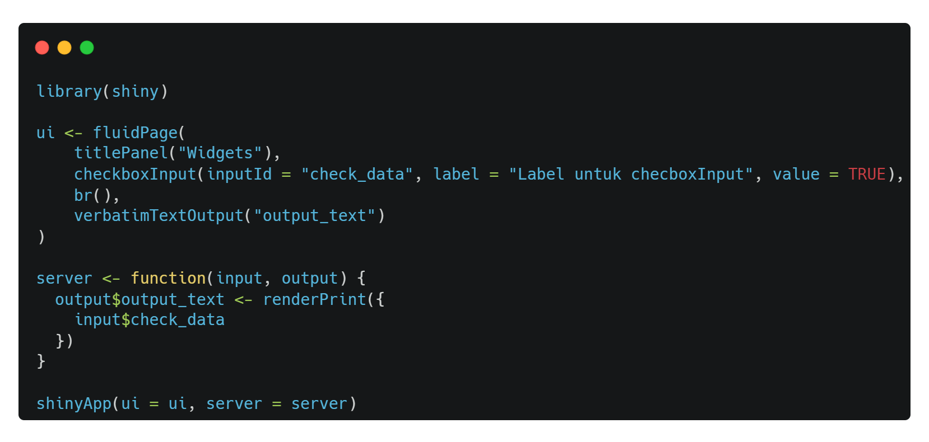
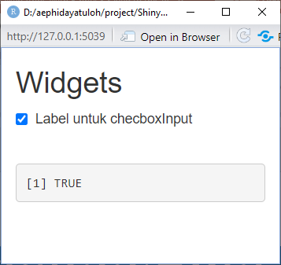
Checkbox Input
checkboxInput(inputId, label, value = FALSE, width = NULL)

Slide 14
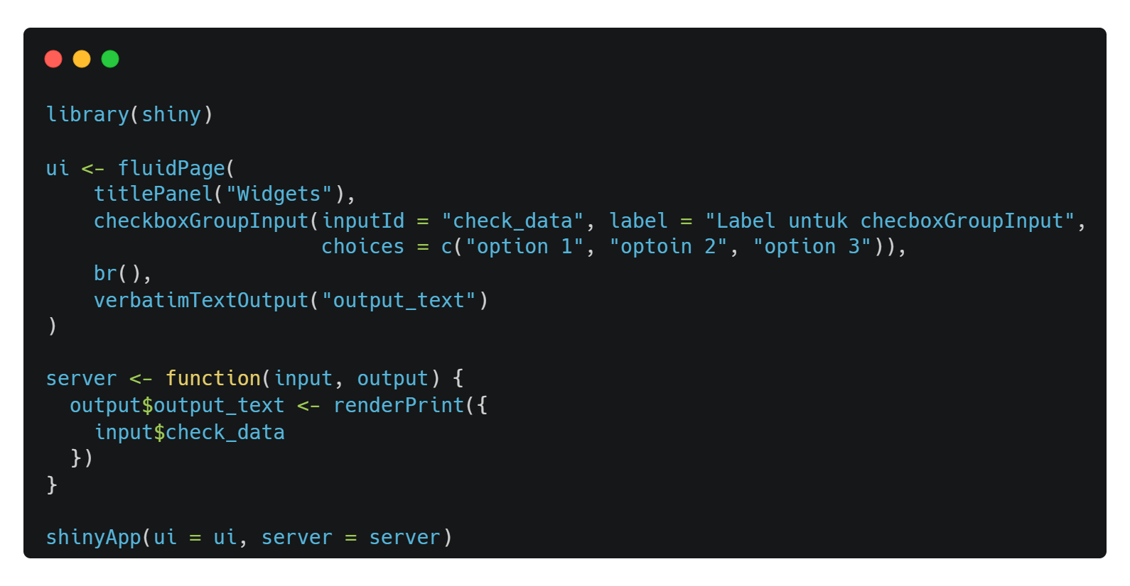
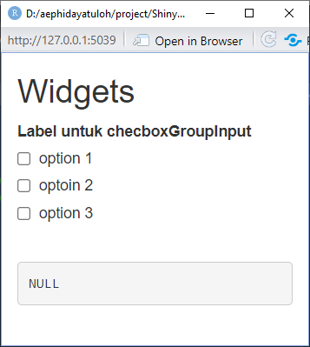
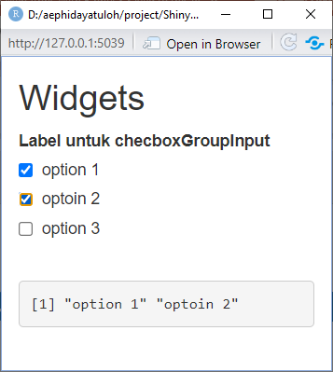
Checkbox Group Input
checkboxGroupInput(inputId, label, choices = NULL, selected = NULL,
inline = FALSE, width = NULL, choiceNames = NULL, choiceValues = NULL)

Slide 15
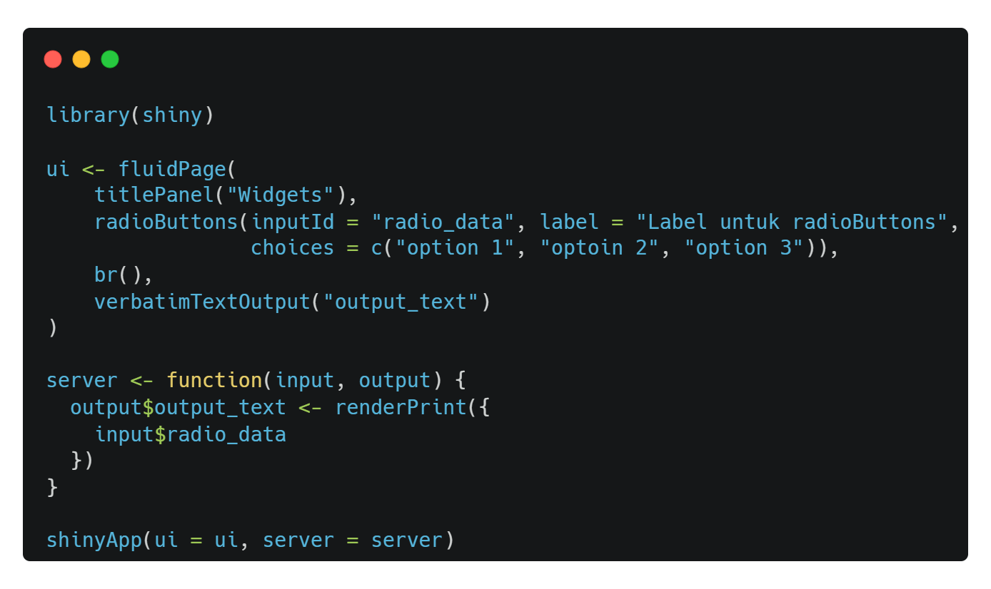
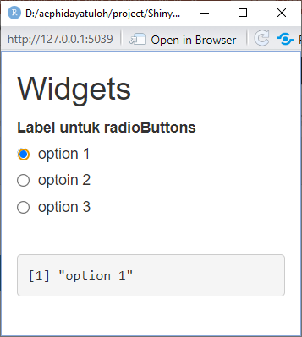
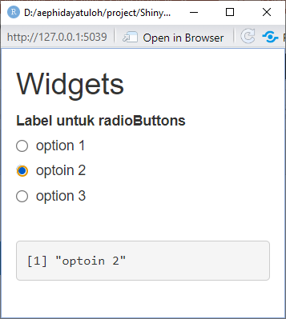
Radio Buttons
radioButtons(inputId, label, choices = NULL, selected = NULL,
inline = FALSE, width = NULL, choiceNames = NULL, choiceValues = NULL)

Slide 16
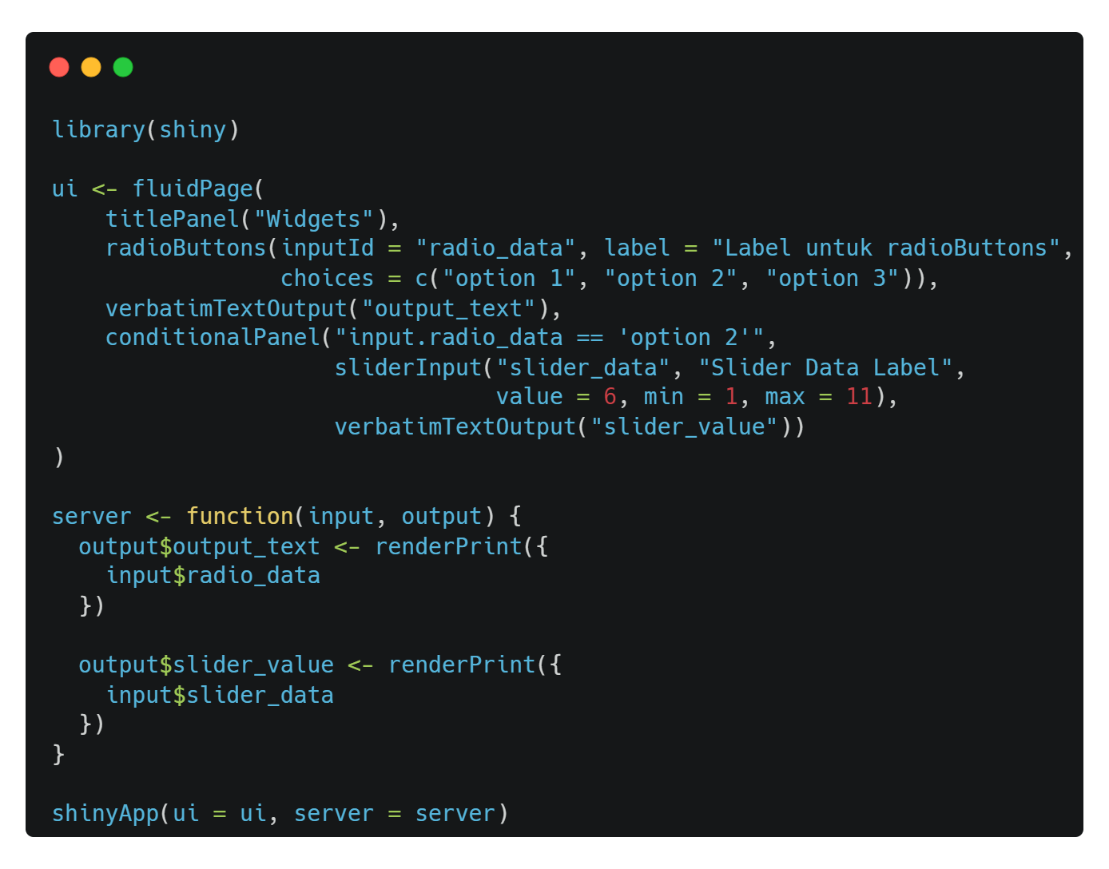
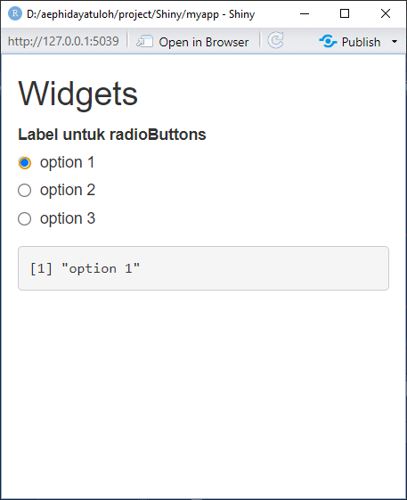
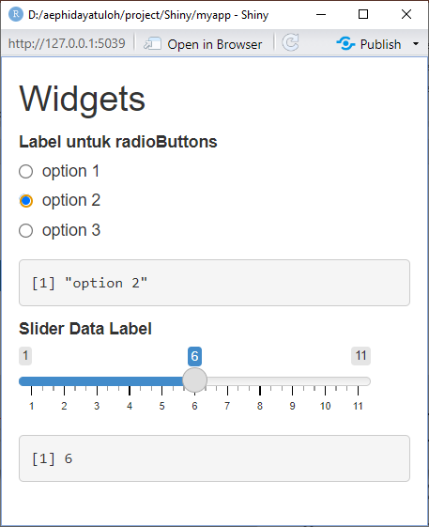
Conditional Panel
conditionalPanel(condition, ..., ns = NS(NULL))

Slide 17
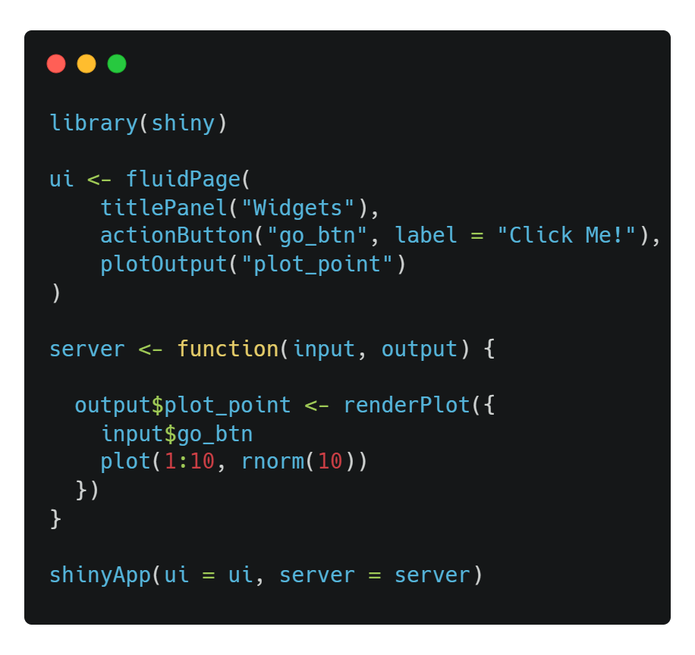
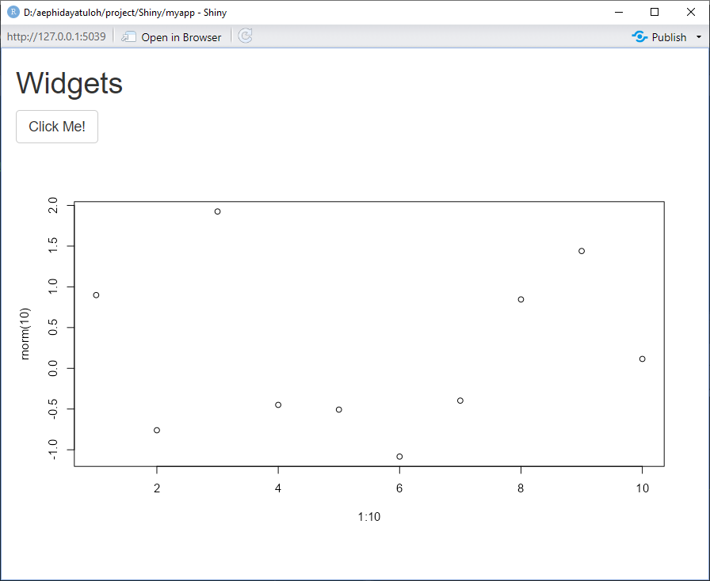
Action Button
actionButton(inputId, label, icon = NULL, width = NULL, ...)

Slide 18
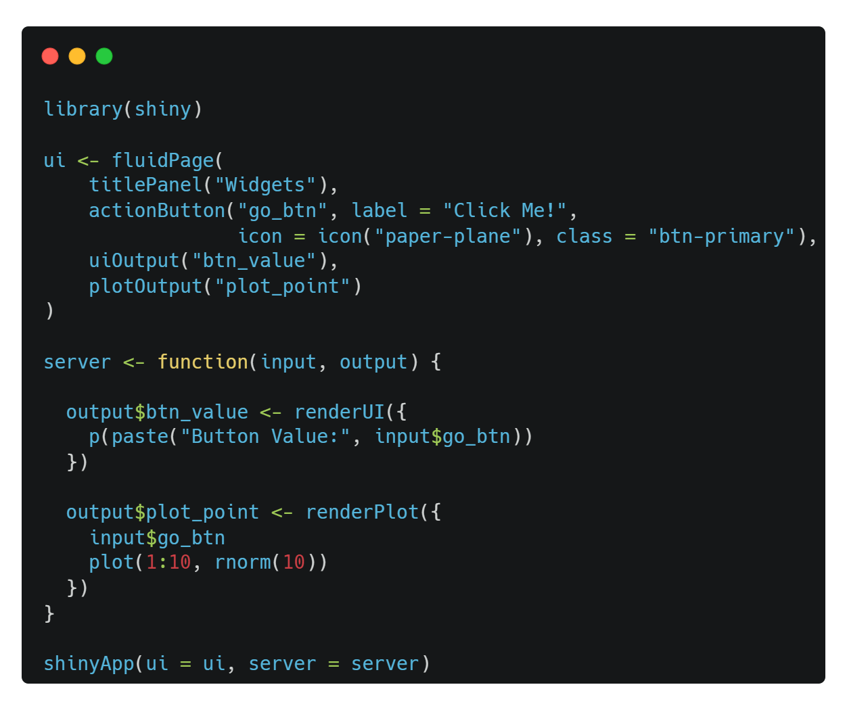
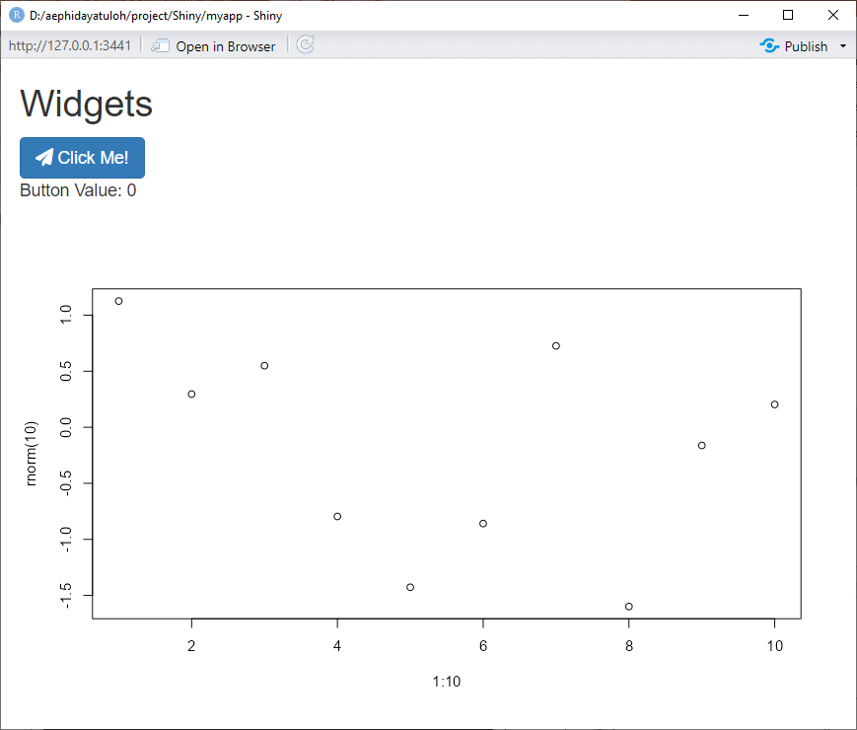
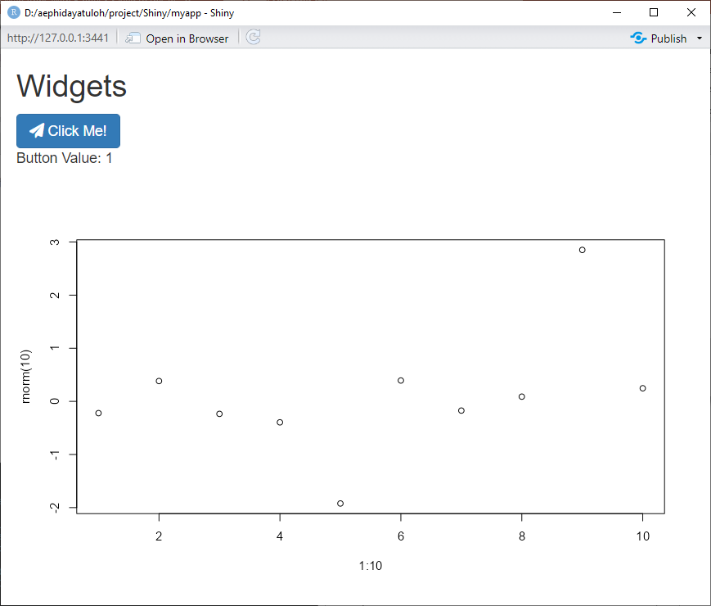
Action Button
actionButton(inputId, label, icon = NULL, width = NULL, ...)
With icon and style

Slide 19
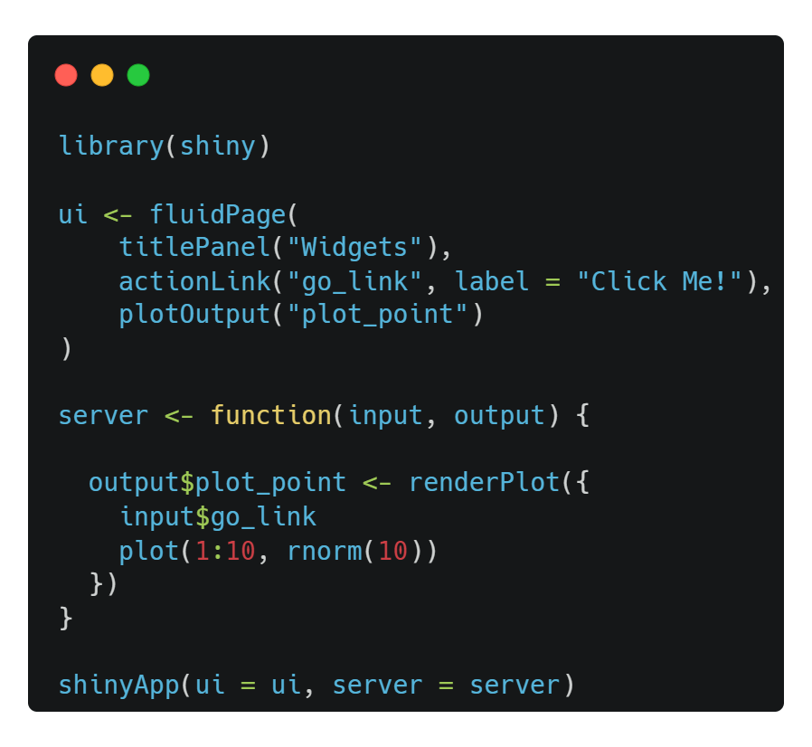
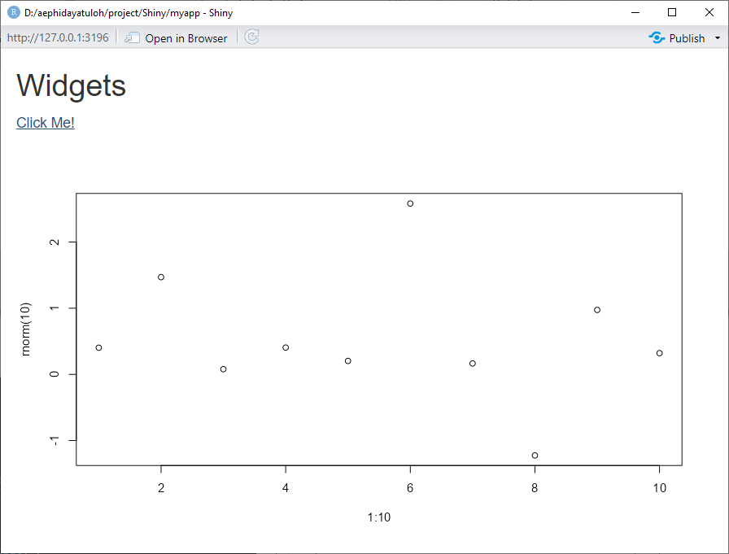
Action Link
actionLink(inputId, label, icon = NULL, ...)

Slide 20
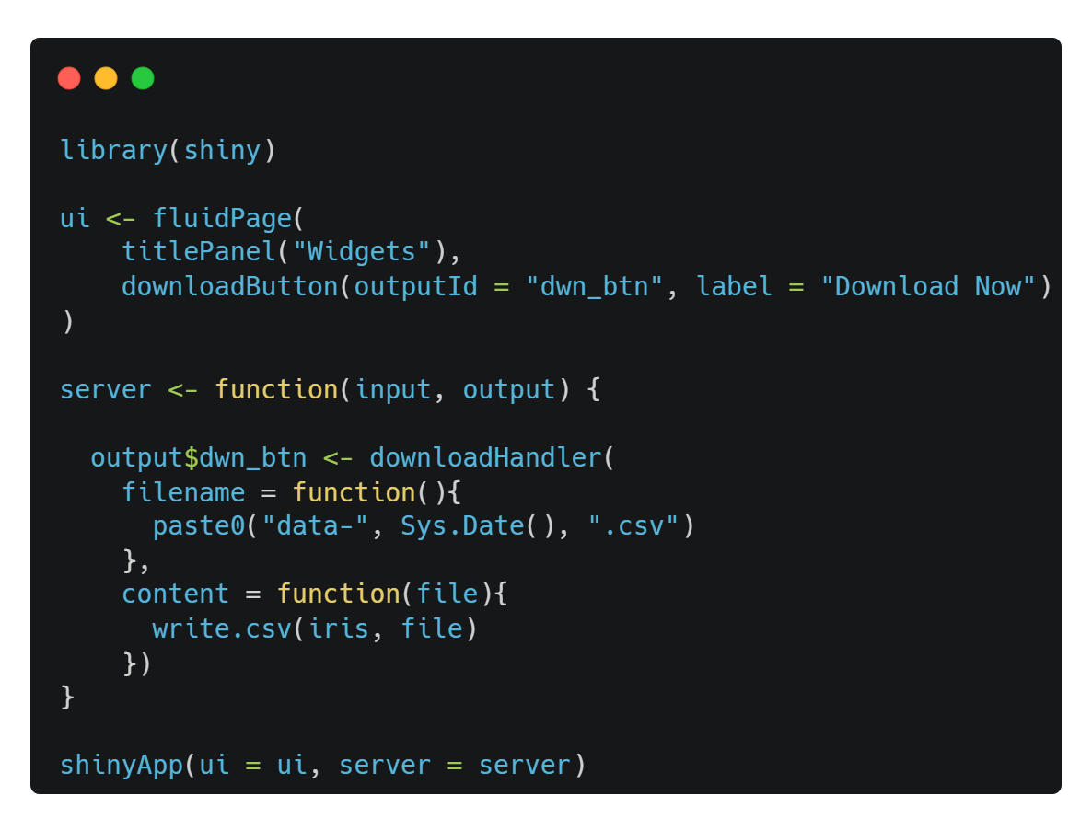
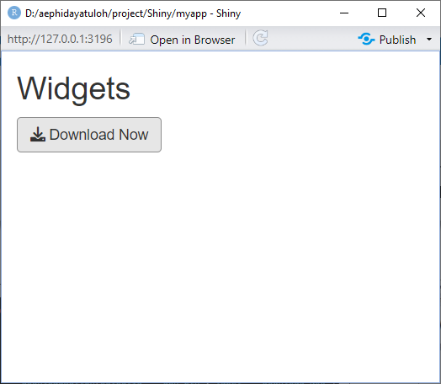
Download Button
downloadButton(outputId, label = "Download", class = NULL, ...,
icon = shiny::icon("download"))

Slide 21
Deliver Output to UI
Shiny App with Two File, ui.R and server.R

Slide 22
Shiny ui and server
ui.R
server.R
User Interface
Computation Processes
User Interface
Control the layout, appearance, widget for user inputs and display the output.
E.g. the title, page layout, text input, radio button, dropdown menu, graphics output etc.
Server
Set of instructions that uses the input provided by user, process them and produces the required output which is further displayed by ui.R

Slide 23
Create the Brain
All processes are done in server.
All generated objects (vector, table, plot, text, UI etc.) based on input should be created in reactive function (reactive(), render*(), observe() etc.).
render*() → *Output()
ui | server
tableOutput("preview") | output$preview <- renderTable()
uiOutput("graphTitle") | output$graphTitle <- renderUI()
plotOutput("plots") | output$plots <- renderPlot()
verbatimTextOutput("prints") | output$prints <- renderPrint()
textOutput("text") | output$text <- renderText()

Slide 24
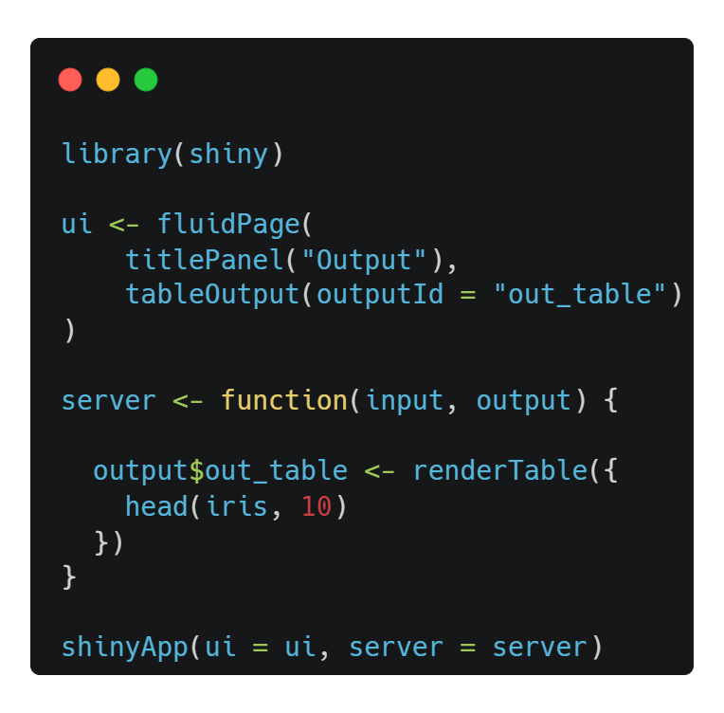
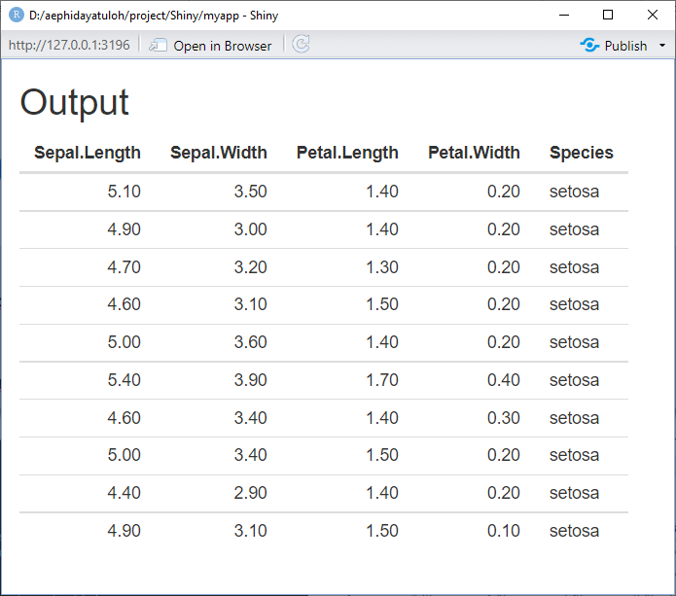
Table Output
# ui
tableOutput(outputId = "<outputId>")
# server
output$<outputId> <- renderTable({…})

Slide 25
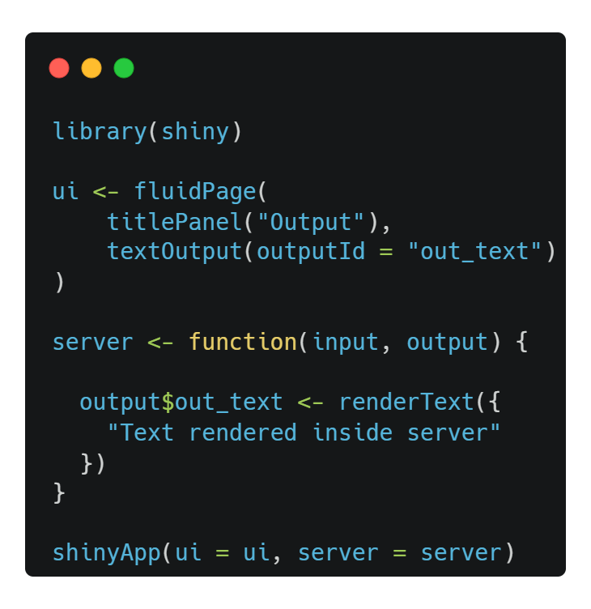
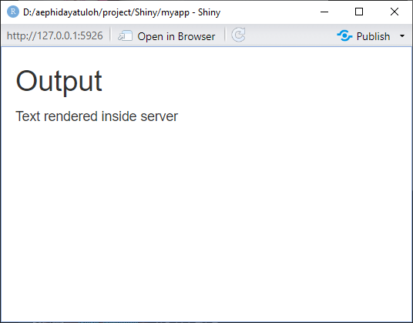
Text Output
# ui
textOutput(outputId = "<outputId>")
# server
output$<outputId> <- renderText({…})

Slide 26
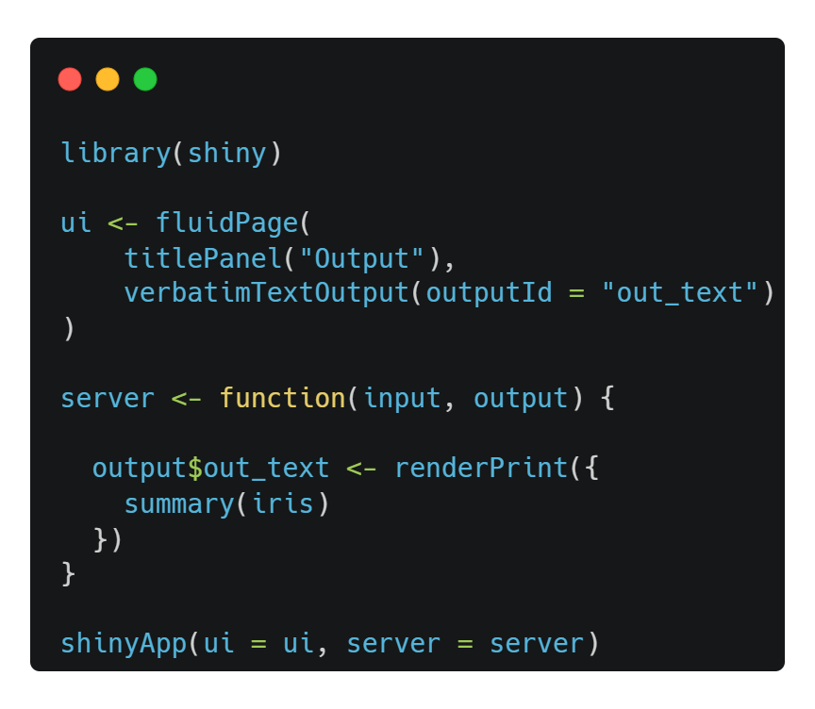
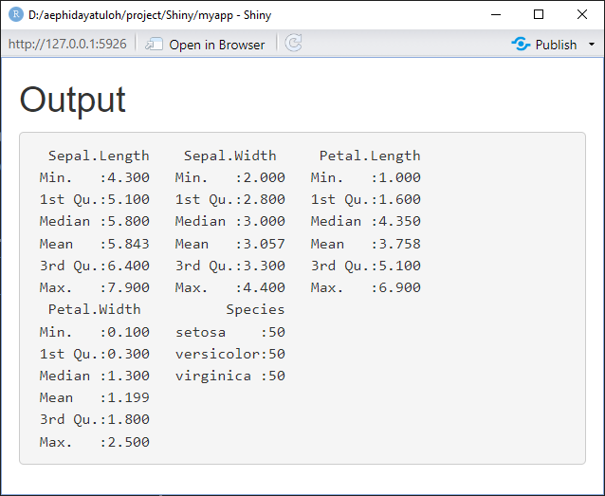
Verbatim Text Output
# ui
verbatimTextOutput(outputId = "<outputId>")
# server
output$<outputId> <- renderPrint({…})

Slide 27
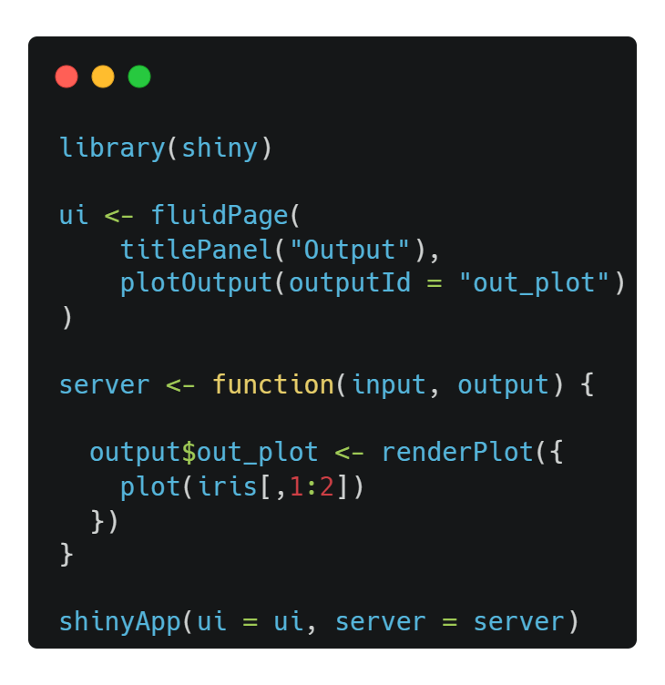
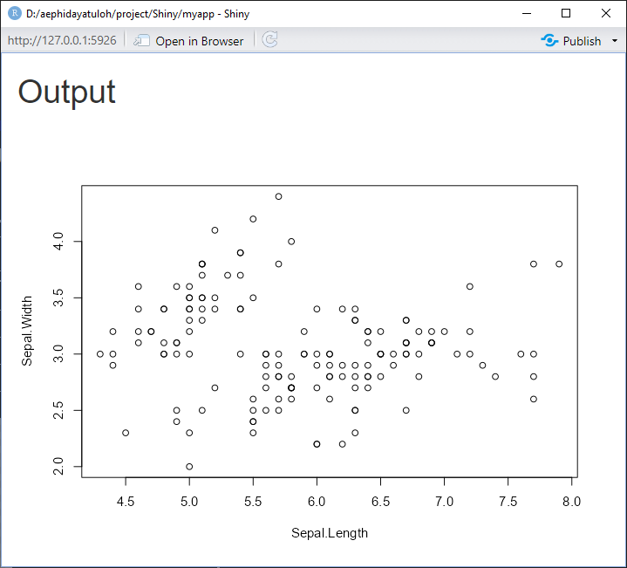
Plot Output
# ui
plotOutput(outputId = "<outputId>")
# server
output$<outputId> <- renderPlot({…})

Slide 28
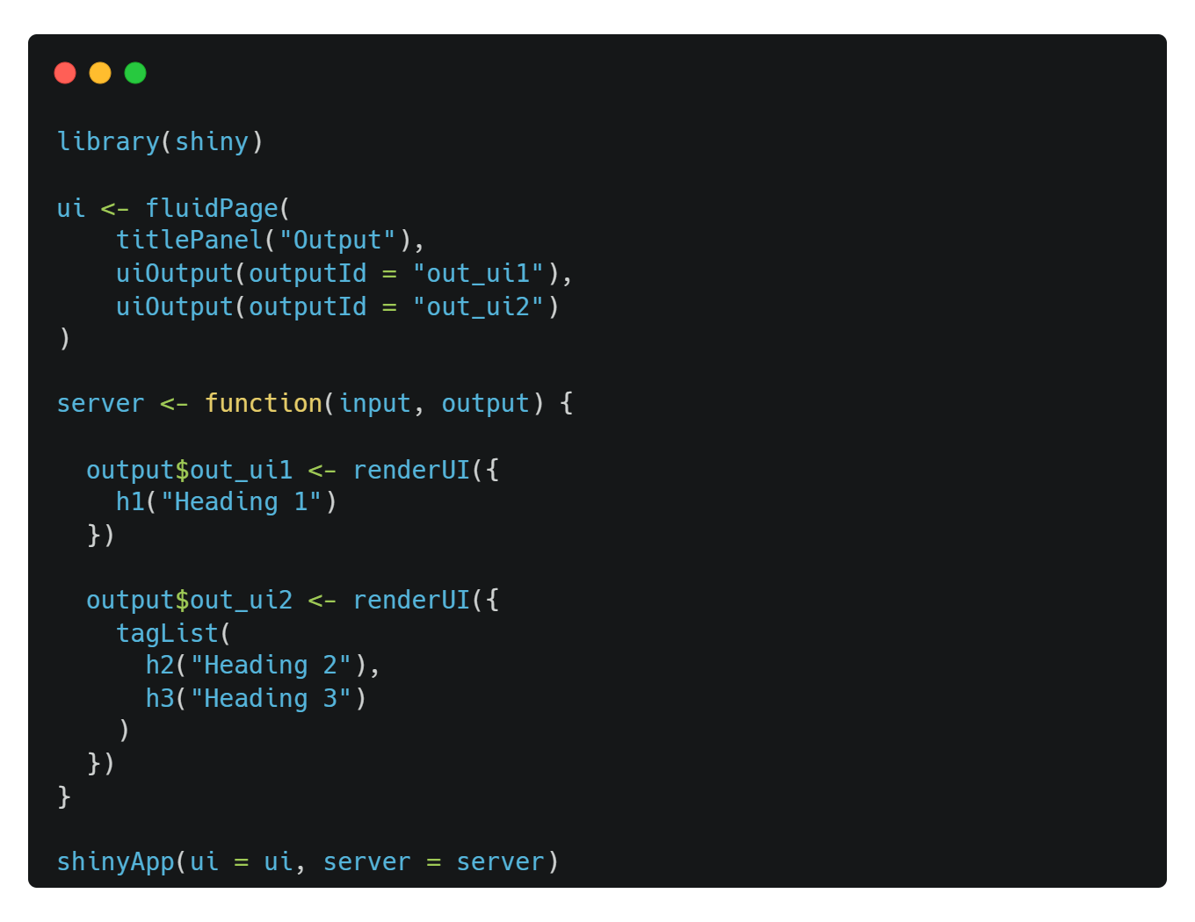

UI Output
# ui
uiOutput(outputId = "<outputId>")
# server
output$<outputId> <- renderUI({…})

Slide 29
Other Packages
Package | ui | server
plotly | plotlyOutput("plotly") | output$plotly <- renderPlotly()
highcharter | highchartOutput("hc") | output$hc <- renderHighchart()
echarts4r | echarts4rOutput ("echarts") | output$echarts <- renderEcharts4r()
wordcloud2 | wordcloud2Output("wc2") | output$wc2 <- renderWordcloud2()
DT | dataTableOutput("out_dt") | output$out_dt <- renderDataTable()
networkD3 | sankeyNetworkOutput("sankey") | output$sankey <- renderSankeyNetwork()

Slide 30
Summary
We can use widgets as input for the interactivity
Use different inputId for each widgets and use input$<inputId> in server to get it’s value
Use render*() in server to process and create the output
Use *Output() to display the created output

